Slide 1

DIVERSITY OF PYTHON PROGRAMMING
View Mastering Python course details at http://www.edureka.co/python
For Queries:
Post on Twitter @edurekaIN: #askEdureka
Post on Facebook /edurekaIN
For more details please contact us:
US : 1800 275 9730 (toll free)
INDIA : +91 88808 62004
Email Us : sales@edureka.co

Slide 2
Objectives
At the end of this module, you will be able to
How Python helps to do Analytics
Why Python is trending for Automation
How to do Visualization using Python
Understand where Python is in terms of DataFrames

Slide 3
Why Python?
Python is a great language for the beginner programmers since it is easy-to-learn and easy-to-maintain.
Python’s biggest strength is that the bulk of it’s library is portable. It also supports GUI Programming and can be used to create Applications portable on Mac, Windows and Unix X-Windows system.
With libraries like PyDoop and SciPy, it’s a dream come true for Big Data Analytics.

Slide 4
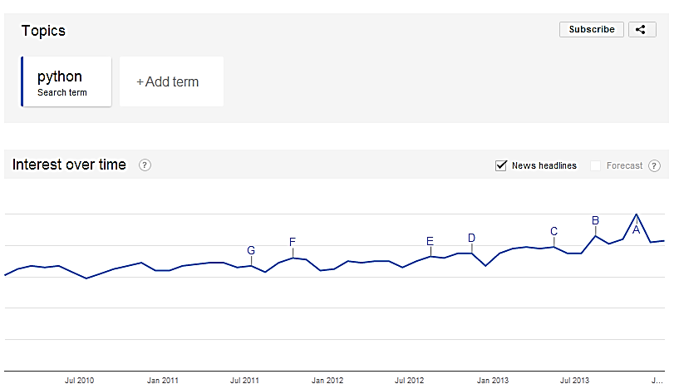
Growing Interest in Python

Slide 5
Demo: Web Scraping using Python
This example demonstrates how to scrape basic financial data from IMDB webpage
We shall use open source web scraping framework for Python called Beautiful Soup to crawl and extract data from webpages
Scraping is used for a wide range of purposes, from data mining to monitoring and automated testing

Slide 6

Demo: Collecting Tweets using Python
This example demonstrates how to extract historical tweets for a particular brand like “nike” or “apple”
We shall make a REST API call to twitter to extract tweets
This data can be further used to perform sentiment analysis for a particular brand on Twitter

Slide 7
Demo: Data Preparation / Cleaning
Extracting Data from JSON
- Extract Data from Complex JSON for further processing.
Stop word analysis for text analytics
- Remove stop words from a text Paragraph for further processing.

Slide 8

PyDoop – Hadoop with Python
Python can be used to write Hadoop MapReduce programs and applications to access HDFS API for Hadoop with PyDoop package
PyDoop package provides a Python API for Hadoop MapReduce and HDFS
PyDoop has several advantages over Hadoop’s built-in solutions for Python programming, i.e., Hadoop Streaming and Jython
One of the biggest advantage of PyDoop is it’s HDFS API. This allows you to connect to an HDFS installation, read and write files, and get information on files, directories and global file system properties
The MapReduce API of PyDoop allows you to solve many complex problems with minimal programming efforts. Advance MapReduce concepts such as ‘Counters’ and ‘Record Readers’ can be implemented in Python using PyDoop

Slide 9
Demo: Python NLTK on Hadoop
Leveraging Analytical power of Python on Big Data Set. (MR + NLTK)
Perform stop word removal using Map Reduce.

Slide 10
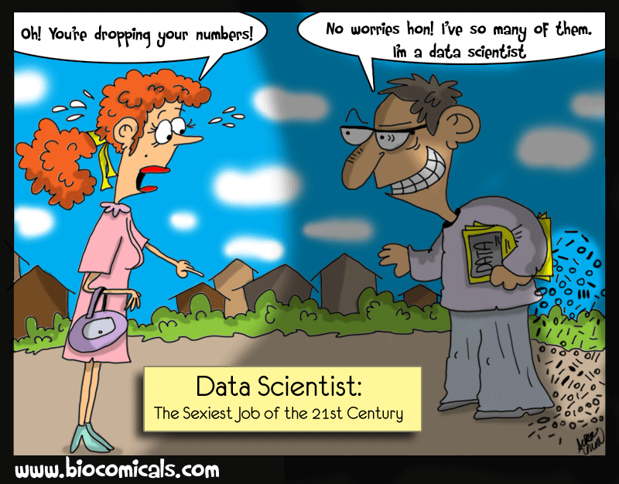
Python and Data Science
The day-to-day tasks of a data scientist involves many interrelated but different activities such as accessing and manipulating data, computing statistics and , creating visual reports on that data, building predictive and explanatory models, evaluating these models on additional data, integrating models into production systems, etc.
Python is an excellent choice for Data Scientist to do his day-to-day activities as it provides libraries to do all these things
Python has a diverse range of open source libraries for just about everything that a Data Scientist does in his day-to-day work
Python and most of its libraries are both open source and free

Slide 11
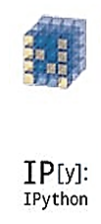


SciPy.org
SciPy (pronounced “Sigh Pie”) is a Python-based ecosystem of open-source software for mathematics, science, and engineering.
NumPy
Base N-dimensional
array package
SciPy library
Base N-dimensional
array package
Matplotlib
Comprehensive 2D Plotting
IPython
Enhanced Interactive
Console
pandas
Data structures and analysis
Sympy
Symbolic mathematics

Slide 12
Demo: Zombie Invasion Model
This is a lighthearted example, a system of ODEs(Ordinary differential equations) can be used to model a "zombie invasion", using the equations specified by Philip Munz.
The system is given as:
dS/dt = P - B*S*Z - d*S
dZ/dt = B*S*Z + G*R - A*S*Z
dR/dt = d*S + A*S*Z - G*R
There are three scenarios given in the program to show how Zombie Apocalypse vary with different initial conditions.
This involves solving a system of first order ODEs given by: dy/dt = f(y, t) Where y = [S, Z, R].
Where:
S: the number of susceptible victims
Z: the number of zombies
R: the number of people "killed”
P: the population birth rate
d: the chance of a natural death
B: the chance the "zombie disease" is transmitted (an alive person becomes a zombie)
G: the chance a dead person is resurrected into a zombie
A: the chance a zombie is totally destroyed

Slide 13
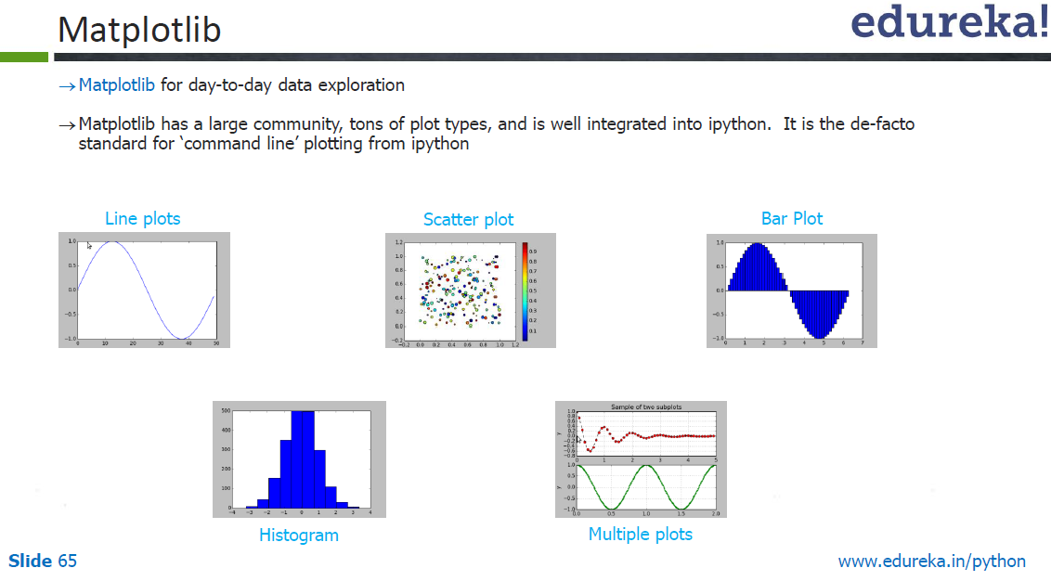

Slide 14
Demo – Line, Scatter, Bar, Histogram, Multiple Plot

Slide 15
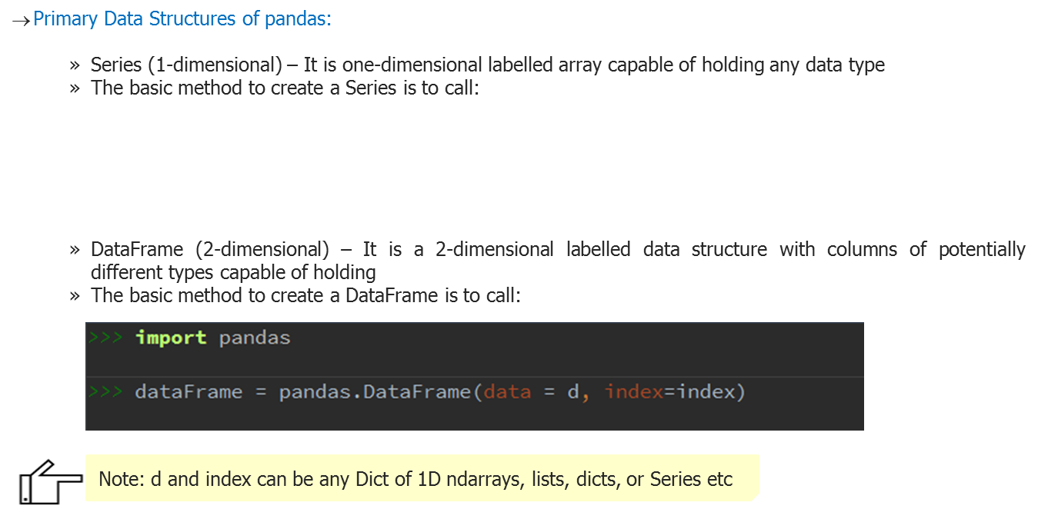
Python Pandas – Data Frames

Slide 16



Demo : Python Pandas
Using the huge movie data-set (movie rating, user details etc. ) that is being collected now a days, we need to do the below analysis:
Find the top 5 rated movies
Find the Top 5 movies rated across age – groups
Find on which movies do women and men most disagree on?

